Slide 1
TABLE OF CONTENT
EXECUTIVE SUMMARY
DETAILED ANALYSIS
RECOMMENDATION

Slide 2
EXECUTIVE SUMMARY
The total sales generated across all years amount to $1,928,888, with a total profit of $247,962. Technology is the highest contributing category in terms of profit, whereas Phones and Chairs are top in sales volume. Sub-categories like Copiers and Phones had the highest profits, while Tables and Bookcases operated at a loss.
The customer base peaked in 2022 (638 customers), followed by a slight decline in subsequent years. The Top 5 customers generated a combined revenue of $87,369, contributing to approximately 4.5% of total sales. with Sean Miller being the highest contributor at $25,035.
California, New York, and Texas are the top-performing states in terms of sales. West Virginia, North Dakota, and Maine show the lowest sales figures. Sales peak in December and November, suggesting strong seasonal demand in Q4.
Total profitability increased year-over-year from 2021 to 2023, peaking in 2023 before a dip in 2024.

Slide 3
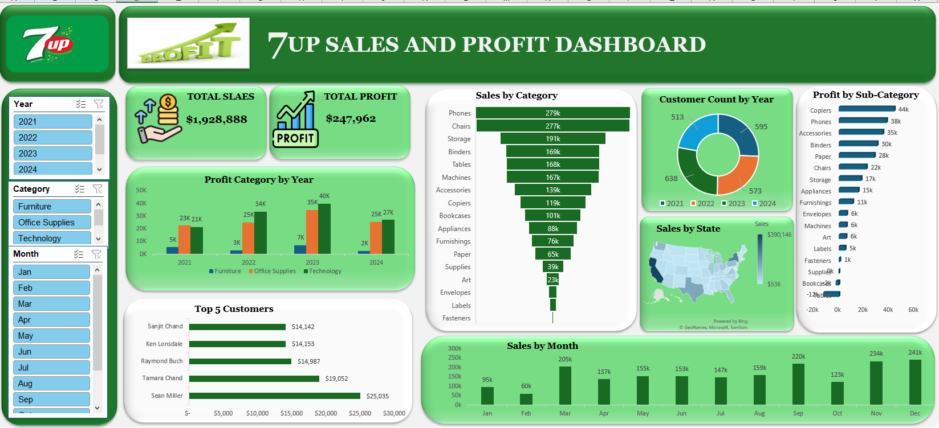
SALES AND PROFIT OVERVIEW

Slide 4
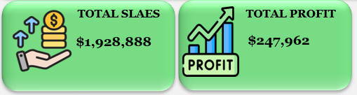
DETAILED ANALYSIS
Total Sales and Profit (All Years Combined)
Total Sales: $1,928,888
Total Profit: $247,962
These values are aggregated from the complete dataset (2021–2024).

Slide 5
DETAILED ANALYSIS (Cont’d)
Sales and Profit by Product Category
Technology has consistently contributed the most to overall profit.
Furniture shows lower profitability and relatively inconsistent sales volume year-over-year.
Category | Total Sales | Total Profit
Technology | Highest | Highest
Office Supplies | Moderate | Moderate
Furniture | Lowest | Lowest

Slide 6
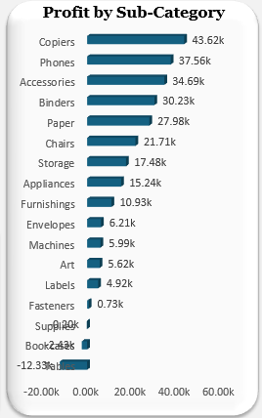
DETAILED ANALYSIS (Cont’d)
Profit by Sub-Category
Technology leads in profitability due to high-performing items like Copiers and Phones.
Negative profits were recorded in Tables (12.33K), Bookcases(2.43K), and Supplies(0.2k), indicating they may be operating at a loss.

Slide 7
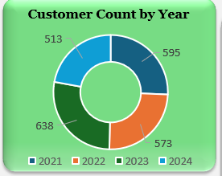
DETAILED ANALYSIS (Cont’d)
Customer Count Trend Over the Years
Growth from 2021 to 2022 suggests effective acquisition or market expansion.
Post-2022 decline may indicate retention or competition challenges.

Slide 8
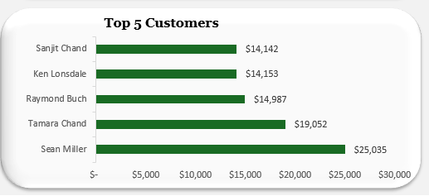
DETAILED ANALYSIS (Cont’d)
Top 5 Customers by Sales
These five customers alone contribute a significant portion of the business, suggesting the potential value of loyalty initiatives.

Slide 9
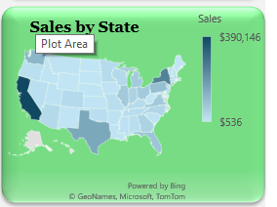
DETAILED ANALYSIS (Cont’d)
The highest and lowest performing states
Top 5 States by Sales
State | Total Sales ($)
California | 390,145.54
New York | 246,517.74
Texas | 151,436.60
Washington | 117,661.47
Pennsylvania | 95,494.86
Bottom 5 States by Sales
State | Total Sales ($)
West Virginia | 536.48
North Dakota | 891.53
Maine | 1,270.53
South Dakota | 1,290.06
Wyoming | 1,603.14

Slide 10
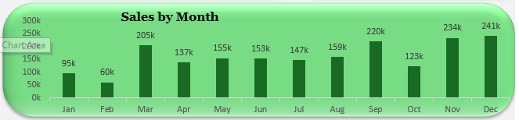
DETAILED ANALYSIS (Cont’d)
Monthly Sales Trend (Across All Years)
Insight: Sales build throughout the year and spike dramatically in Q4 (October–December), indicating strong seasonal performance—likely due to holidays and year-end promotions.

Slide 11
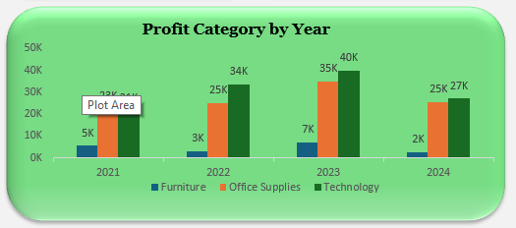
DETAILED ANALYSIS (Cont’d)
Year-over-Year Profit Trend
Profit rose steadily from 2021 through 2023 but declined by 20.7% in 2024, potentially due to reduced margins, higher costs, or lower sales.

Slide 12
Recommendations
Invest in Top Sub-Categories: Scale product lines like Copiers, Phones, and Accessories through bundling or marketing. Reassess Loss-Making Areas: Evaluate Tables, Bookcases, and Supplies for potential discontinuation or reengineering. Optimize Furniture Category: Look for opportunities to reduce costs or improve design appeal to improve profit margins.
Develop a Customer Retention Program: Focus on why customer count dropped after 2022—this could involve CRM strategies, loyalty incentives, or customer feedback loops. Re-engage Lapsed Customers: Review lost customers from 2023–2024 and initiate reactivation campaigns.
Target Low-Performing States: Launch region-specific campaigns or explore distribution partnerships in West Virginia, North Dakota, etc. Maximize Q4 Sales: Increase inventory and promotional campaigns ahead of September–December to leverage high seasonal demand. Test Off-Season Promotions: Run targeted discounts or loyalty offers in slower months like February to smoothen revenue cycles.
Review 2024 Operational Costs: Understand what caused the profit drop after 2023—consider adjusting supply chain, discounts, or SKUs.

